Slide 1

Concept & Operation for AVL Tree
Data Structure | Tree and Heap
Course: Data Structure | Chapter: Tree and Heap | Program: Bachelor of Engineering
DISCOVER · LEARN · EMPOWER
Notes:
Welcome everyone to today's lecture on AVL Trees. We are diving deep into the 'Tree and Heap' chapter to understand how we maintain balance in binary search trees. This concept is crucial for ensuring our algorithms remain efficient even as data grows. Let's begin by exploring the core definition and why it matters.

Slide 2
Course Outcomes
SLIDE 2 / 14
Course Outcome
CO | BT LEVEL | DESCRIPTION
CO1 | BT1 | Understand and apply basic data structures, algorithms, complexity analysis, ADTs, arrays and linked lists.
CO2 | BT2 | Apply and implement stacks and queues in problem-solving.
CO3 | BT3 | Analyse and apply searching, sorting, and hashing techniques.
CO4 | BT4 | Construct and apply tree structures and traversal techniques.
CO5 | BT5 | Represent and solve graph problems using DFS, BFS, and graph algorithms.
Chandigarh University
2 / 14
Notes:
Today's lecture directly addresses our Course Outcomes. CO1 requires us to understand and apply basic data structures, which AVL trees exemplify perfectly through their balancing logic. While CO2 focuses on stacks and queues, the underlying principles of ADTs and complexity analysis we discuss here form the foundation for those structures as well.

Slide 3
Learning Objectives
SLIDE 3 / 14
Learning Outcomes
1
Define the AVL tree and its height-balancing property.
2
Explain the role of the balance factor in maintaining order.
3
Identify the four rotation types used for rebalancing.
4
Analyze the time complexity of AVL operations compared to BST.
5
Demonstrate the step-by-step insertion process with a numerical example.
Chandigarh University
3 / 14
Notes:
By the end of this session, you will be able to define an AVL tree and explain its height-balancing property. You will learn to identify the four rotation types used for rebalancing and analyze the time complexity of AVL operations. Finally, we will demonstrate the step-by-step insertion process with a numerical example to solidify your understanding.

Slide 4
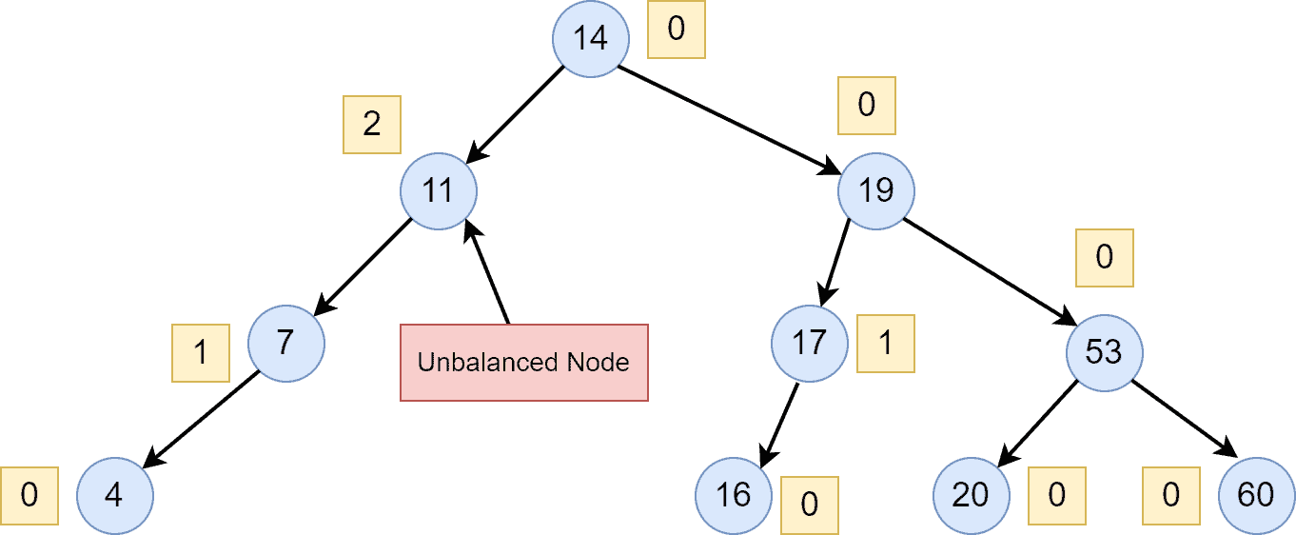
Lecture
SLIDE 4 / 14
Definition of AVL Tree
1
An AVL tree is a self-balancing Binary Search Tree (BST).
2
It was named after inventors Adelson-Velsky and Landis.
3
Every node must satisfy the height-balancing property strictly.
4
The height difference between left and right subtrees is at most 1.
5
This property ensures the tree height remains logarithmic O(log n).
6
Without this, a BST can degenerate into a linked list structure.
7
The balance factor is the key metric for checking tree validity.
Red-Black Tree vs. AVL Tree | Baeldung on Computer Science
Chandigarh University
4 / 14
Notes:
An AVL tree is a self-balancing Binary Search Tree named after inventors Adelson-Velsky and Landis. Every node must satisfy the height-balancing property strictly, meaning the height difference between left and right subtrees is at most 1. This property ensures the tree height remains logarithmic O(log n), preventing the tree from degenerating into a linked list structure which would slow down operations significantly.

Slide 5
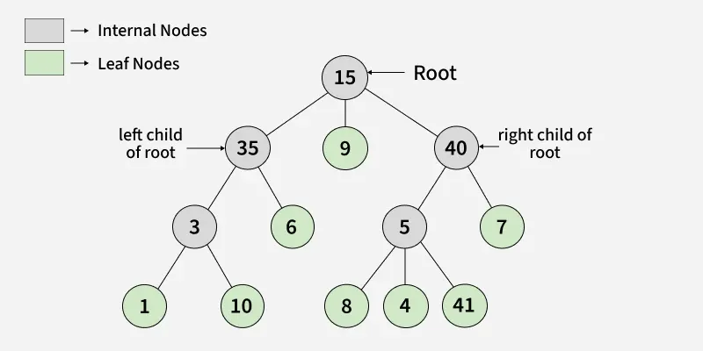
Lecture
SLIDE 5 / 14
The Balance Factor Concept
GOVERNING EQUATION
Balance factor = Height(Left Subtree) - Height(Right Subtree)
1
A valid AVL node must have a balance factor of -1, 0, or 1.
2
A value of 2 or -1 indicates the tree is unbalanced.
3
We calculate this factor after every insertion or deletion operation.
4
If the factor exceeds the limit, a rotation is immediately triggered.
5
This metric acts as the trigger mechanism for rebalancing algorithms.
6
It ensures that no single path becomes significantly longer than others.
Source: media.geeksforgeeks.org
Chandigarh University
5 / 14
Notes:
The balance factor is calculated as the height of the left subtree minus the height of the right subtree. A valid AVL node must have a balance factor of -1, 0, or 1, while a value of 2 or -1 indicates the tree is unbalanced. We calculate this factor after every insertion or deletion operation, and if the factor exceeds the limit, a rotation is immediately triggered to restore balance.

Slide 6
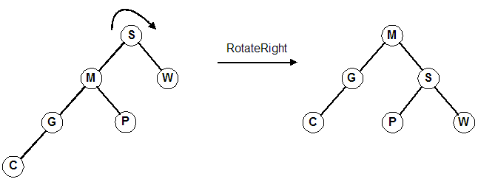
Lecture
SLIDE 6 / 14
Why Rotations are Necessary
1
Rotations restructure the tree without violating the BST property.
2
They preserve the in-order traversal sequence of the data elements.
3
Rotations reduce the height of the unbalanced subtree locally.
4
They are the only mechanism to fix balance factor violations.
5
There are four distinct rotation types based on insertion position.
6
The operation is local, affecting only the node and its children.
7
This ensures O(1) time complexity for the rebalancing step itself.
Source: pontus.digipen.edu
Chandigarh University
6 / 14
Notes:
Rotations restructure the tree without violating the BST property, preserving the in-order traversal sequence of the data elements. They reduce the height of the unbalanced subtree locally and are the only mechanism to fix balance factor violations. There are four distinct rotation types based on insertion position, and the operation is local, affecting only the node and its children to ensure O(1) time complexity.

Slide 7
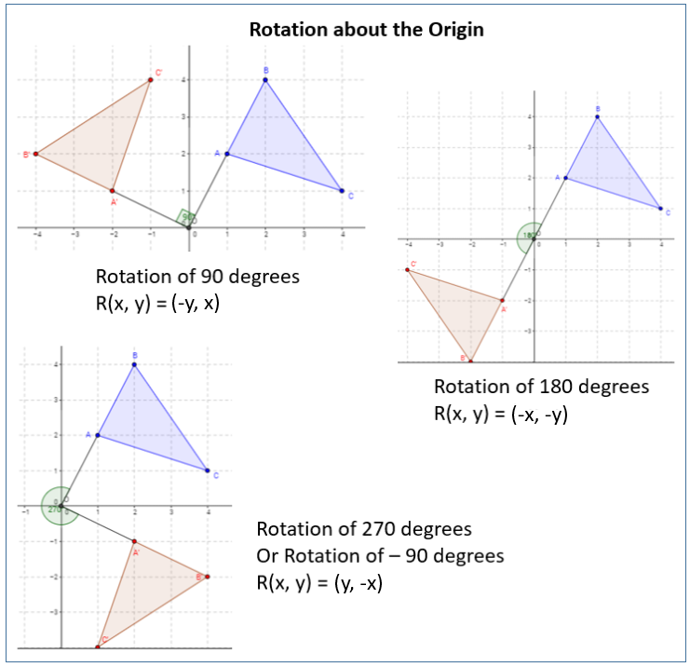
Lecture
SLIDE 7 / 14
Left Rotation Explained
GOVERNING EQUATION
Used when the right subtree is heavier (Balance Factor = -2)
1
The right child becomes the new root of the subtree.
2
The original root becomes the left child of the new root.
3
The left child of the new root becomes the right child of the old root.
4
This shifts weight from the right side to the left side.
5
It restores the balance factor to the valid range of -1 to 1.
6
Commonly used in Right-Left and Right-Right imbalance scenarios.
Source: www.onlinemathlearning.com
Chandigarh University
7 / 14
Notes:
A Left Rotation is used when the right subtree is heavier, indicated by a Balance Factor of -2. The right child becomes the new root of the subtree, while the original root becomes the left child of the new root. The left child of the new root becomes the right child of the old root, shifting weight from the right side to the left side to restore the balance factor.

Slide 8
Lecture
SLIDE 8 / 14
Right Rotation Explained
GOVERNING EQUATION
Used when the left subtree is heavier (Balance Factor = 2)
1
The left child becomes the new root of the subtree.
2
The original root becomes the right child of the new root.
3
The right child of the new root becomes the left child of the old root.
4
This shifts weight from the left side to the right side.
5
It restores the balance factor to the valid range of -1 to 1.
6
Commonly used in Left-Left and Left-Right imbalance scenarios.
Source: www.onlinemathlearning.com
Chandigarh University
8 / 14
Notes:
A Right Rotation is used when the left subtree is heavier, indicated by a Balance Factor of 2. The left child becomes the new root of the subtree, while the original root becomes the right child of the new root. The right child of the new root becomes the left child of the old root, shifting weight from the left side to the right side to restore the balance factor.

Slide 9
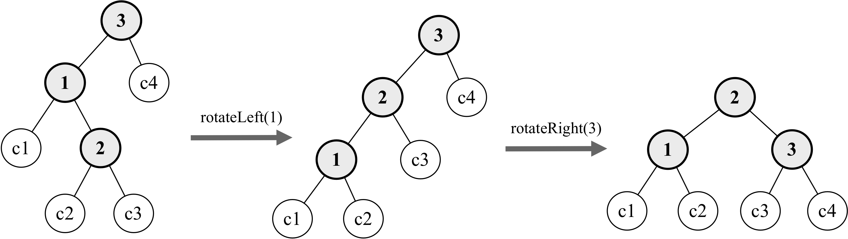
Double Rotations
SLIDE 9 / 14
Left-Right
1
Occurs when a left-heavy node has a right-heavy child.
2
Requires a Left Rotation on the left child first.
3
Followed by a Right Rotation on the original root node.
4
This handles the 'Zig-Zag' imbalance pattern effectively.
5
The middle element of the three becomes the new root.
6
It resolves complex imbalances that single rotations cannot fix.
7
Essential for maintaining balance during specific insertion sequences.
Source: www.oreilly.com
Chandigarh University
9 / 14
Notes:
A Left-Right rotation occurs when a left-heavy node has a right-heavy child, requiring a Left Rotation on the left child first. This is followed by a Right Rotation on the original root node, handling the 'Zig-Zag' imbalance pattern effectively. The middle element of the three becomes the new root, resolving complex imbalances that single rotations cannot fix.

Slide 10
Double Rotations
SLIDE 10 / 14
Right-Left
1
Occurs when a right-heavy node has a left-heavy child.
2
Requires a Right Rotation on the right child first.
3
Followed by a Left Rotation on the original root node.
4
This handles the 'Zig-Zag' imbalance pattern effectively.
5
The middle element of the three becomes the new root.
6
It resolves complex imbalances that single rotations cannot fix.
7
Essential for maintaining balance during specific insertion sequences.
Source: www.oreilly.com
Chandigarh University
10 / 14
Notes:
A Right-Left rotation occurs when a right-heavy node has a left-heavy child, requiring a Right Rotation on the right child first. This is followed by a Left Rotation on the original root node, handling the 'Zig-Zag' imbalance pattern effectively. The middle element of the three becomes the new root, resolving complex imbalances that single rotations cannot fix.

Slide 11
Worked Numerical Example
SLIDE 11 / 14
Insertion
GOVERNING EQUATION
After inserting 30, node 10 becomes unbalanced (Balance Factor = -2)
INSERT SEQUENCE
10, 20, 30, 40, 50, 25.
• Perform Right Rotation on 10 to fix the Right-Right case.
• Insert 40: Node 20 becomes unbalanced (Balance Factor = -2).
• Perform Right Rotation on 20 to restore balance.
• Insert 25: Node 30 becomes unbalanced (Balance Factor = 2).
• Perform Left-Right rotation to fix the Left-Right case.
Chandigarh University
11 / 14
Notes:
Let's trace the insertion sequence: 10, 20, 30, 40, 50, 25. After inserting 30, node 10 becomes unbalanced with a Balance Factor of -2, requiring a Right Rotation. Inserting 40 makes node 20 unbalanced, triggering another Right Rotation. Finally, inserting 25 makes node 30 unbalanced with a Balance Factor of 2, requiring a Left-Right rotation to fix the Left-Right case.

Slide 12
Lecture
SLIDE 12 / 14
Common Pitfalls in AVL Trees
1
Forgetting to update heights after a rotation operation.
2
Calculating balance factor before updating the child's height.
3
Confusing Left-Left with Left-Right rotation triggers.
4
Applying rotation when the tree is already balanced.
5
Ignoring the recursive nature of height updates up the tree.
6
Assuming AVL trees are always faster than simple BSTs.
7
Overlooking the constant overhead of rotations during insertions.
Chandigarh University
12 / 14
Notes:
Common pitfalls include forgetting to update heights after a rotation operation or calculating the balance factor before updating the child's height. Students often confuse Left-Left with Left-Right rotation triggers or apply rotation when the tree is already balanced. It is crucial to remember the recursive nature of height updates up the tree and not assume AVL trees are always faster than simple BSTs due to rotation overhead.

Slide 13
Lecture
SLIDE 13 / 14
Key Takeaways
1
AVL trees maintain O(log n) height via strict balance factors.
2
Balance factor must always be -1, 0, or 1 for validity.
3
Four rotation types (LL, RR, LR, RL) fix all imbalances.
4
Rotations preserve BST order while restoring structural balance.
5
Complexity of search, insert, and delete remains O(log n).
6
Implementation requires careful height tracking and recursive updates.
Chandigarh University
13 / 14
Notes:
To summarize, AVL trees maintain O(log n) height via strict balance factors, ensuring efficient operations. The balance factor must always be -1, 0, or 1 for validity, and four rotation types fix all imbalances. Rotations preserve BST order while restoring structural balance, keeping the complexity of search, insert, and delete at O(log n).

Slide 14
Lecture
SLIDE 14 / 14
References
DATA STRUCTURES
A Pseudocode Approach with C — Gilberg, Forouzan
• Data Structures — Lipschutz
• Data Structure Using C — AK Sharma
• C and Data structure — P. S. Deshpandey
Chandigarh University
14 / 14
Notes:
For further reading, please refer to 'Data Structures: A Pseudocode Approach with C' by Gilberg and Forouzan. You may also consult 'Data Structures' by Lipschutz, 'Data Structure Using C' by AK Sharma, and 'C and Data structure' by P. S. Deshpandey. These texts provide comprehensive coverage of the concepts discussed today.

